Slide 1
PHP (2)

Slide 2
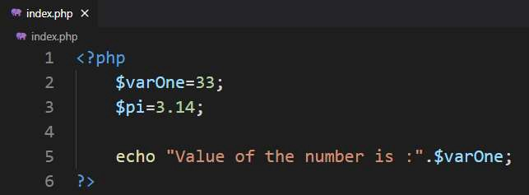
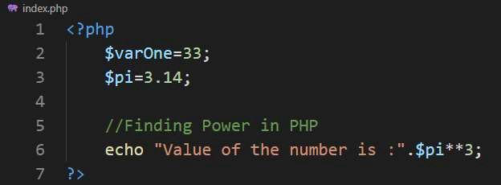
Numbers in PHP (Revison)

Slide 3
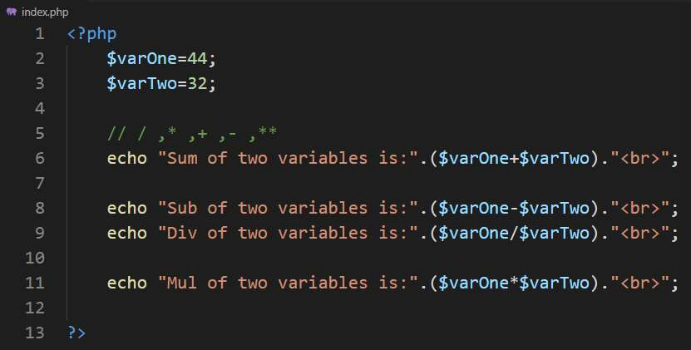
Basic Arithmetic operation (Revison)

Slide 4
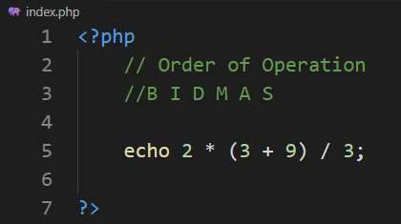
Order of operations
Notes:
Bidmas stands for Brackets, Indices, Division/Multiplication, Addition/Subtraction.

Slide 5
Arrays in PHP
An array is traditionally defined as a group of items that share certain characteristics
Each item consists of two components:
the key and a value
PHP doesn’t require that you assign a size to an array at creation time
Declaring an array:
$array-name[key]=value

Slide 6
Arrays in PHP
Declaring an array:
$array-name[key]=value
$players[0]=“Muhammad Yousuf”;
Adding element in an array:
$players[1]=“Younus Khan”;
Accessing element in an array
echo $players[0];

Slide 7
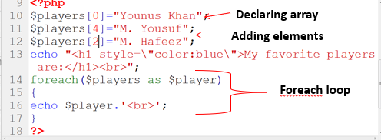
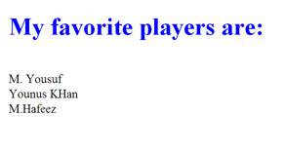
Output

Slide 8
Arrays in PHP
Associative arrays:
$array-name[‘element-name’]=value
$players[‘yousuf’]=“Muhammad Yousuf”;
Adding element in an array:
$players[‘younus’]=“Younus Khan”;
Accessing element in an array:
echo $players[‘yousuf’];

Slide 9
Arrays in PHP
The array(); can also be used to create an array
$array_name=array(item_1,item_2,…item_n);
$players=array(“M.Yoursuf”,”Imran Khan”);
$players=array(“Yousuf”=>“M.Yoursuf”,”imran”=>”Imran Khan”);

Slide 10
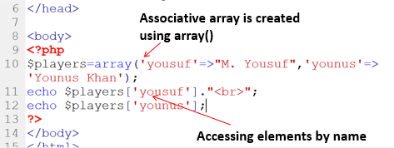

Output

Slide 11
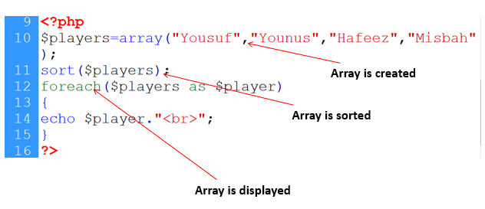
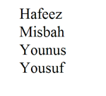
Arrays (Sort)
Sorting arrays:
sort()
rsort()
Output

Slide 12
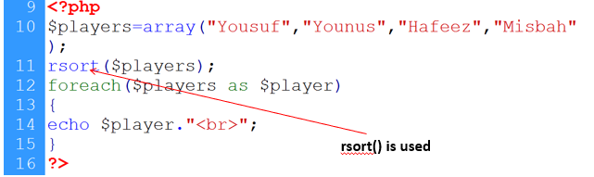
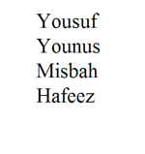
Arrays (Reverse Sort)
Sorting arrays:
sort()
rsort()
Output

Slide 13
Passing Form Data
Forms provide a mean of submitting information from the client to the server
We can create HTML forms using <form> tag
Method and action are the most common attributes of <form>

Slide 14
Passing Form Data
action - gives the URL of the application that is to receive and process the forms data
method - sets the HTTP method that the browser uses to send the form's data to the server for processing
most common methods are POST or GET

Slide 15
Passing Form Data
Get method : all form data is encoded into the URL, appended the action URL as query string parameters
Asad
asd@gmail.com
submit
Action page name
Input field name
Value entered by user

Slide 16
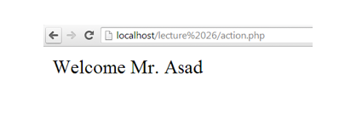
Passing Form Data
Post method: form data appears within the message body of the HTTP request

Slide 17
Super Global Variables
PHP automatically makes few variables available in your program
These are array variables and can be accessed by name
These variables are called super-global variables because they can be accessed without regard to scope
$_GET: contains all the query string variables that were attached to the URL
$_POST: contains all the submitted form variables and their data

Slide 18
Super Global Variables
<body>
<form method=“get” action=“action.php”>
<input type=“text” name=“name”>
<input type=“text” name=“email”>
<input type=“submit”>
</form>
</body>
Rubab
rubabjavaid@ucp.edu.pk
submit
Action.php
<?php
$name = $_GET[‘name’];
$email = $_GET[‘email’];
?>
name
email
$_GET
Rubab
rubabjavaid@ucp.edu.pk

Slide 19
Post Method
<body>
<form method=“post”>
<input type=“text” name=“name”>
<input type=“text” name=“email”>
<input type=“submit”>
</form>
</body>
Rubab
rubabjavaid@ucp.edu.pk
submit
Action.php
<?php
$name = $_POST[‘name’];
$email = $_POST[‘email’];
?>
$_POST
Rubab
rubabjavaid@ucp.edu.pk
name
email

Slide 20
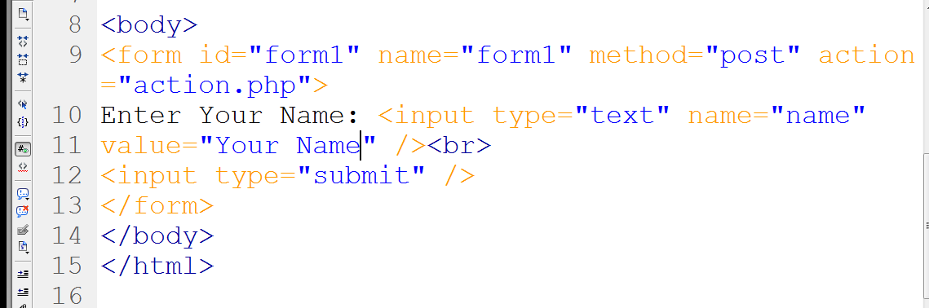
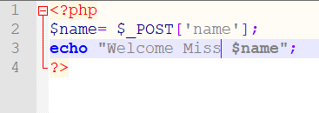
Passing data (Example)
Post Method
Text field
Text field name
Data is received
Display a message

Slide 21
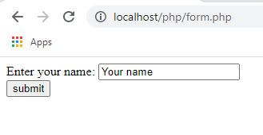
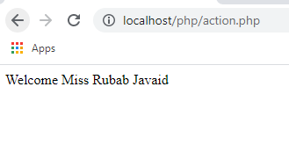
Passing data (Example) - Output
form.php
action.php

Slide 22
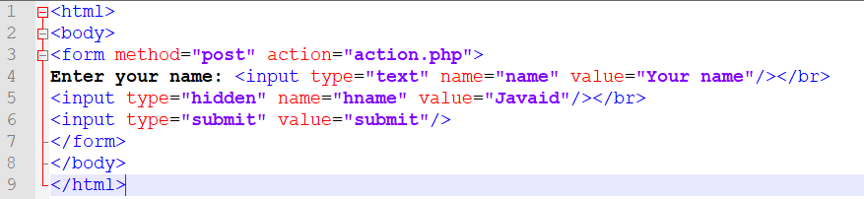
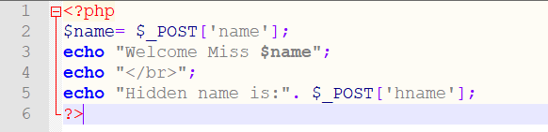
Passing data (Example)
Hidden field
Accessing hidden value

Slide 23
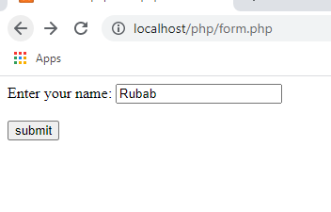
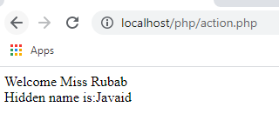
Passing data (Example) - Output
form.php
action.php

Slide 24
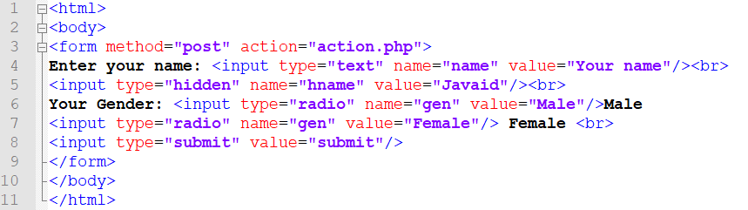
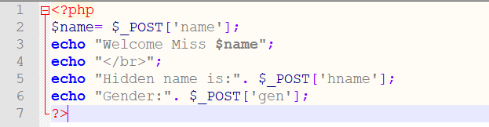
Getting value from radio buttons
Hidden field

Slide 25
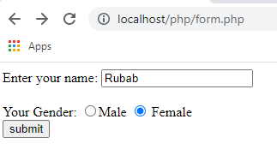
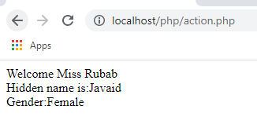
Getting data from radio buttons- Output
form.php
action.php

Slide 26
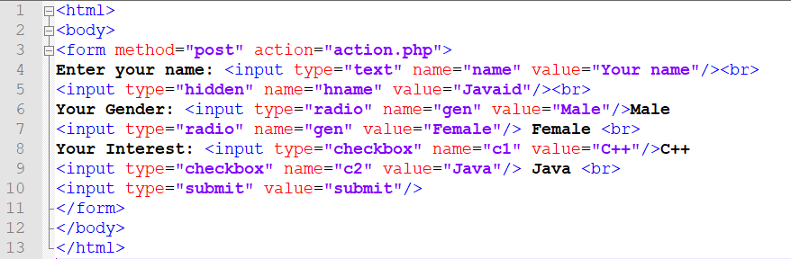
Getting value from checkboxes

Slide 27
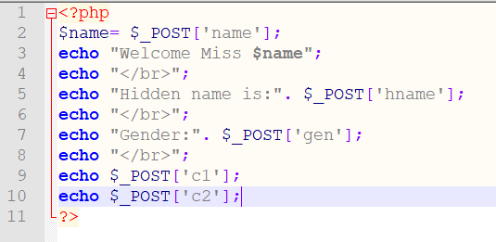
Getting value from checkboxes

Slide 28
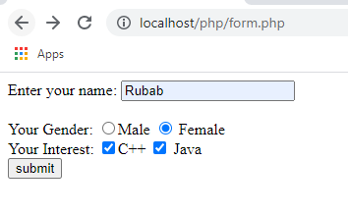
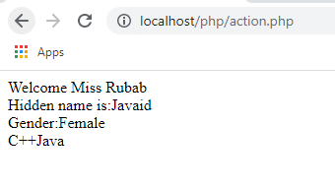
Getting data from Check Boxes - Output
form.php
action.php

Slide 29
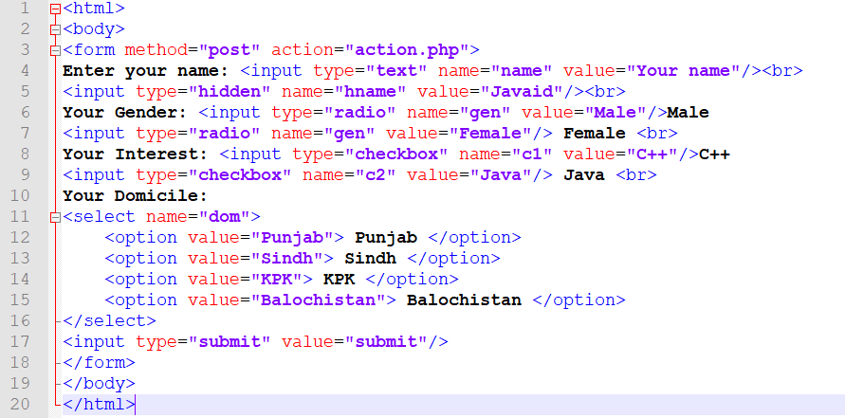
Select Box

Slide 30
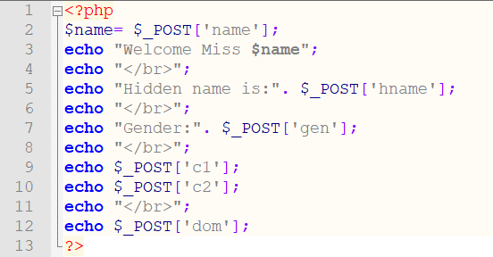
Getting value from select box

Slide 31
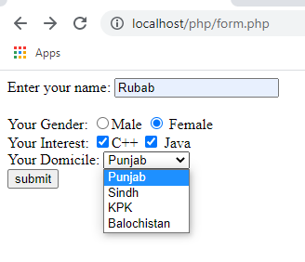
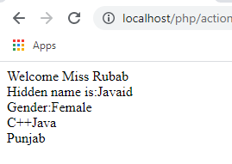
Getting data from Select Box-Output
form.php
action.php

